Slide 1
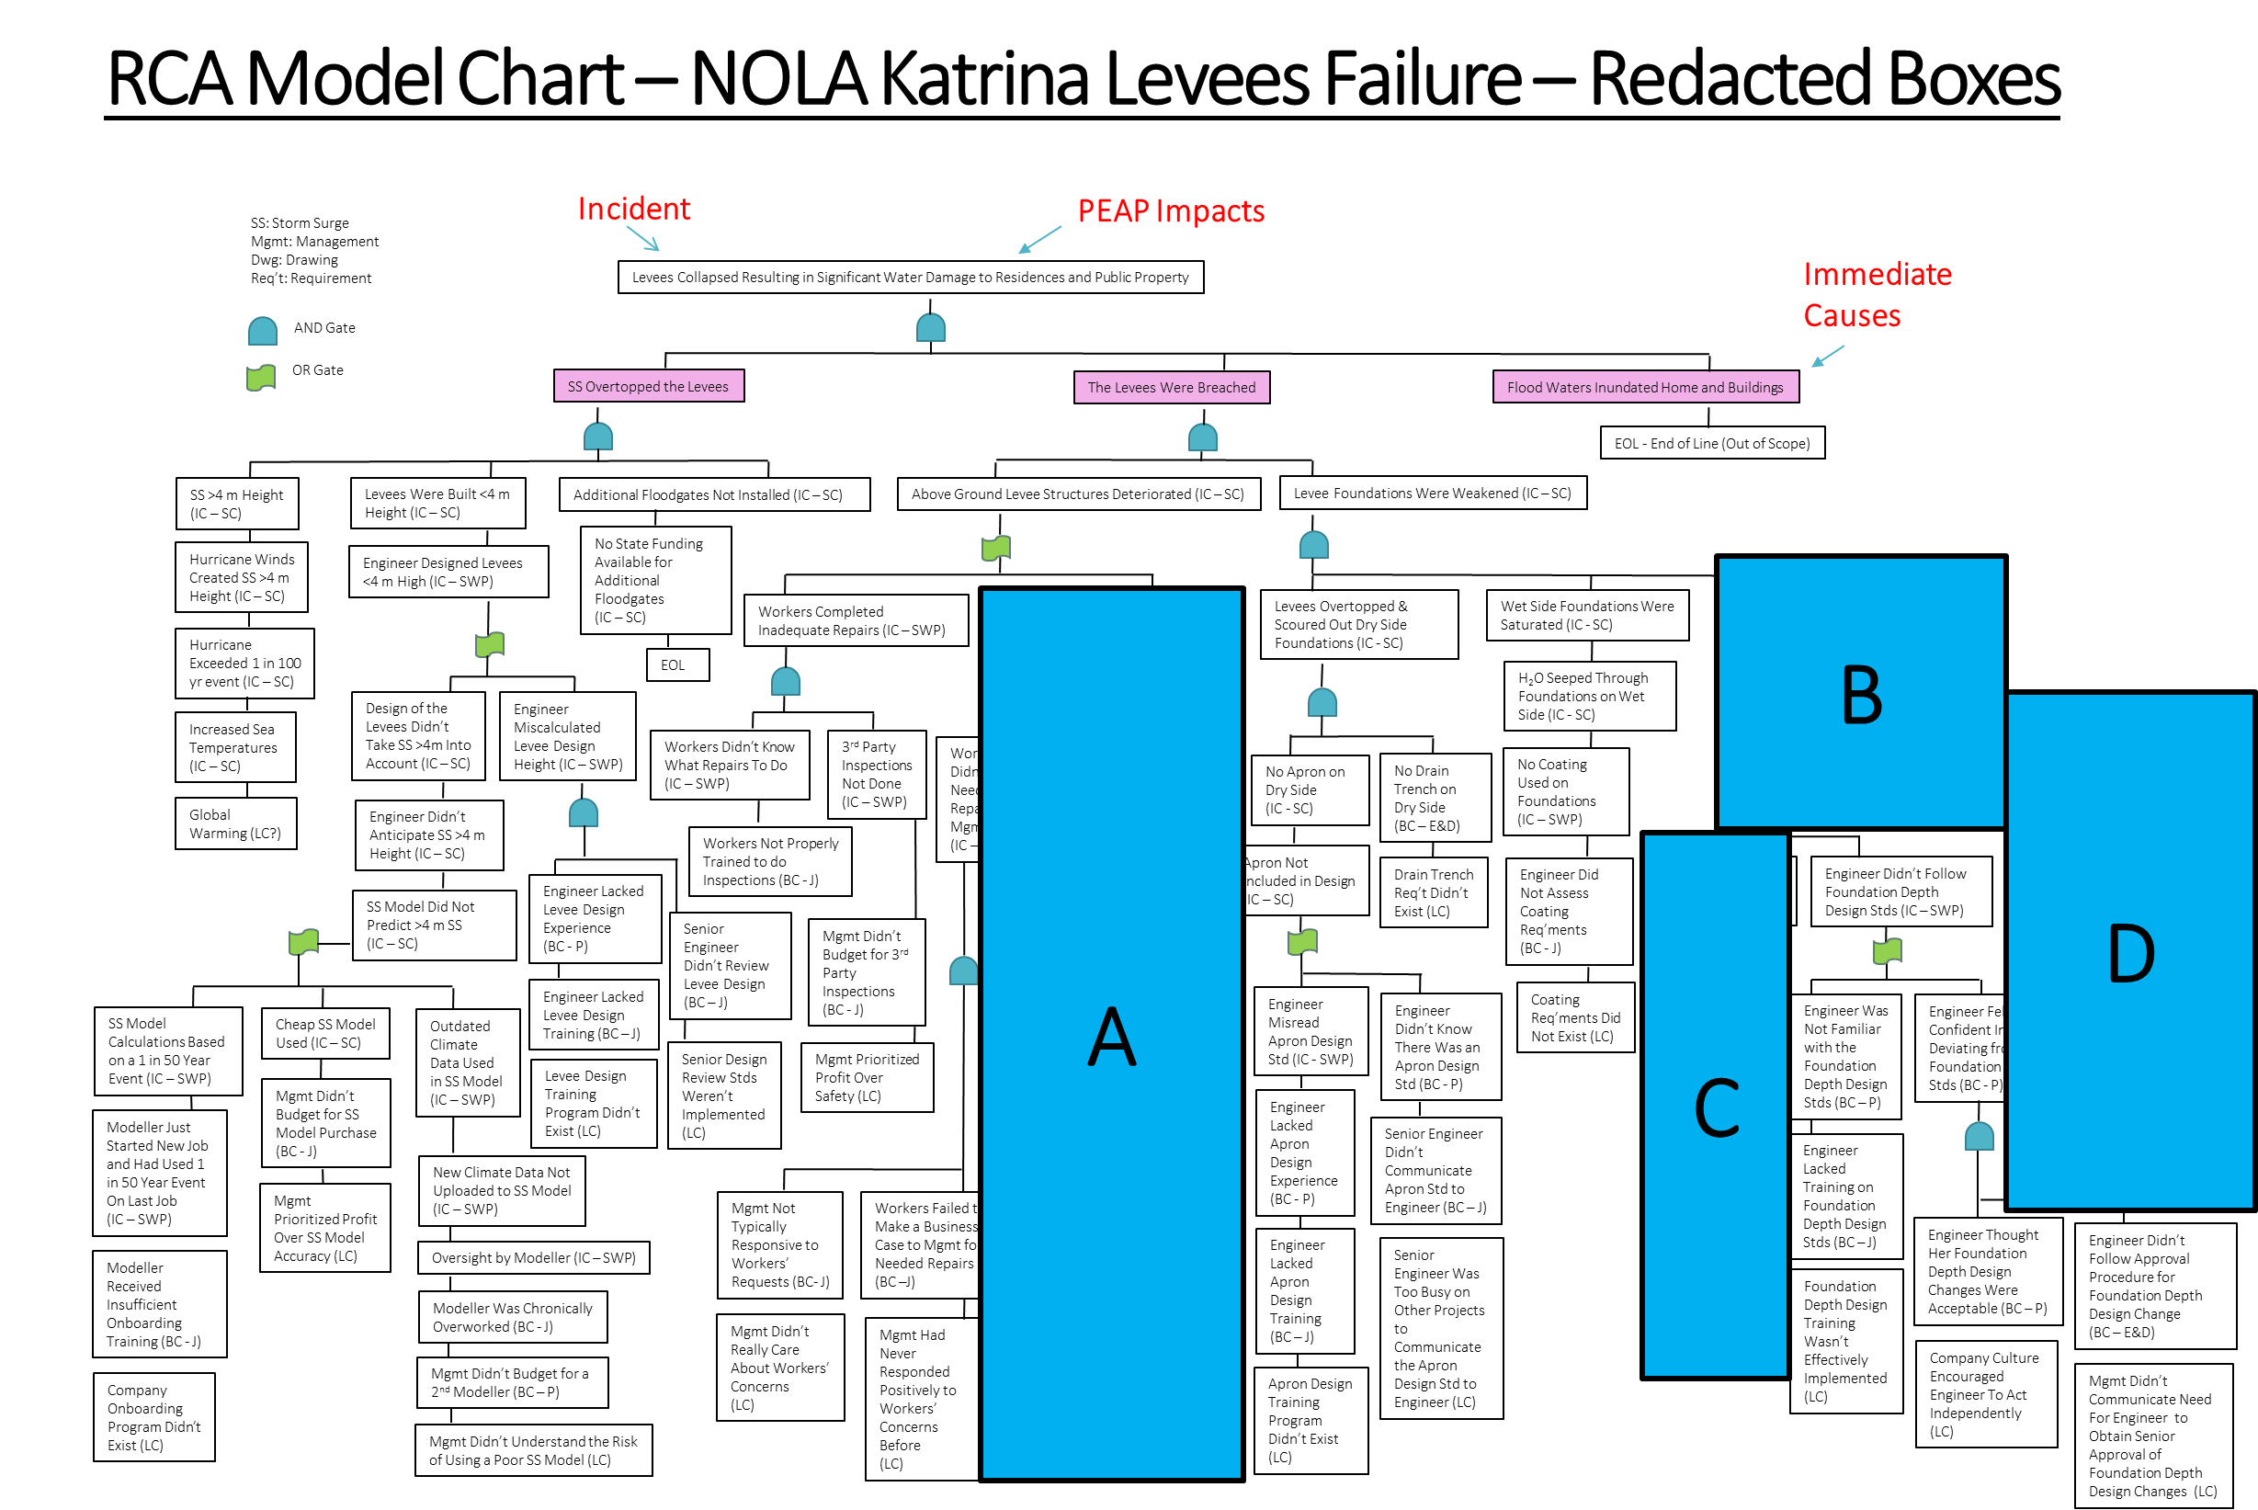

Slide 2
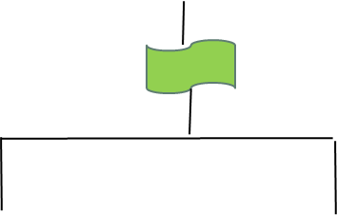
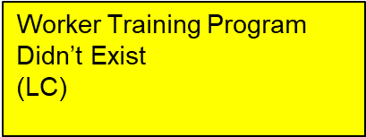

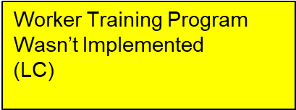


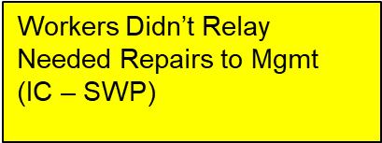
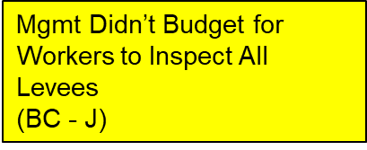

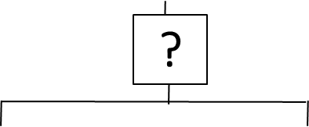
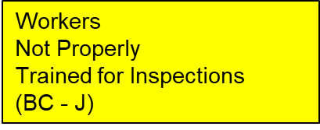

RCA Model Chart – NOLA Katrina Levees Failure, Box A
Build the roots that are in Box A:
Click on a box or gate to select and move it.
Arrange the yellow boxes, use the two “OR” gates, and determine and use the type of the third gate.
Use straight lines to connect the boxes.

Slide 3



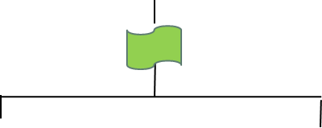
RCA Model Chart – NOLA Katrina Levees Failure, Box B
Build the roots that are in Box B:
Arrange the yellow boxes, use the one “OR” gates, and determine and use the type of the second gate; you may wish to look at Box C to make the connection between Box B and Box C.

Slide 4
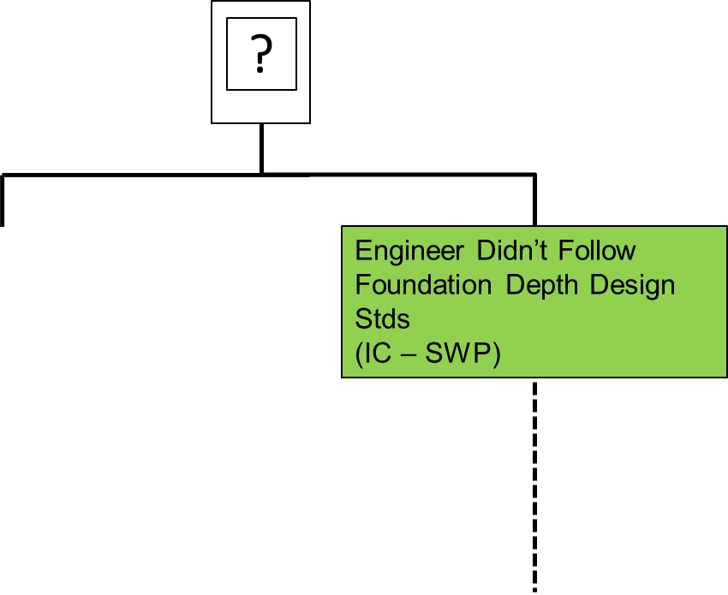
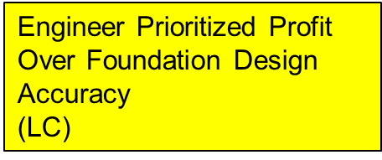
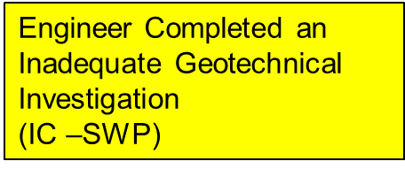

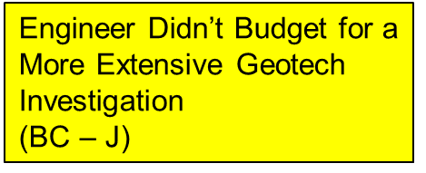
RCA Model Chart – NOLA Katrina Levees Failure, Box C
Build the roots that are in Box C:
Arrange the yellow boxes. You may wish to look at Box B to make the connection between Box B and Box C.

Slide 5

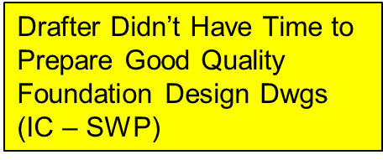

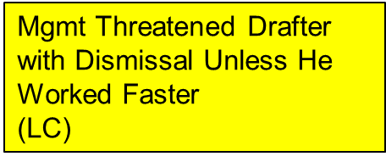
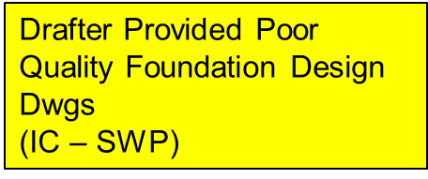

RCA Model Chart – NOLA Katrina Levees Failure, Box D
Build the roots that are in Box D:
Arrange the yellow boxes. You may wish to look at Box B to make the connection between Box B and Box C.

